Slide 1
SECURE DATA HIDING IN IMAGES USING STEGNOGRAPHY
CAPSTONE PROJECT
Presented By: Tasneem Sultana Syed
Student Name : Tasneem Sultana Syed
College Name & Department : PBR Visvodaya Institute Of Technology and Science & Computer Science Engineering

Slide 2
OUTLINE
Problem Statement
Technology used
Wow factor
End users
Result
Conclusion
Git-hub Link
Future scope

Slide 3
Problem Statement
The rise of cyber threats and the increased dependency on digital communication have led to the growing importance of data security. While traditional text encryption methods are prevalent, embedding sensitive information directly into images offers an additional layer of security. This project demonstrates how to embed and retrieve encrypted messages within an image’s pixel values using Python’s OpenCV library. The process is protected with a password to ensure only authorized users can decrypt the message.
Core Challenge: Safely hiding information without altering the image’s appearance
Importance: Image-based encryption is crucial for applications in digital watermarking and secure communication.

Slide 4
Technology used
1.Python 3.x: The primary programming language for this project.
2.Libraries:
OpenCV: For image loading, manipulation, and saving.
Os: Facilitates file handling and opening of the output images.
String: Used for character and string manipulation.
3.Environment:
Cross-platform support (Windows, Linux, MacOS) ensures that this solution is versatile.
4.Encryption Mechanism:
Character Conversion: Each character in the message is converted to its ASCII equivalent.
Pixel Manipulation: The ASCII values are embedded into the image’s RGB channels (Red, Green, Blue).
Sequential Embedding: The embedding is done across different pixels to reduce visibility and distortion.
5.Decryption Mechanism:
Password Validation: Ensures that only users with the correct password can access the message.
Reverse Mapping: Converts pixel values back to characters based on the same mapping technique used
during encryption.

Slide 5
Wow factors
Data Hiding without Distortion: The image is altered so subtly that the human eye cannot easily detect any changes.
Password Protection: Only users who know the password can successfully decrypt and retrieve the embedded message, adding a security layer.
Dynamic Channel Utilization: The project utilizes all three RGB channels, optimizing the storage of encrypted messages.
Educational Demonstration of Steganography: This project introduces basic principles of steganography—a field of hiding information within other media.
Potential for Complex Encryption Layers: The system is designed for easy expansion, allowing for the integration of more complex encryption techniques in the future.

Slide 6
End users
Developers: Those looking to explore simple encryption techniques for image processing applications.
Cybersecurity Enthusiasts: Individuals keen on learning about steganography and hidden message encryption.
Digital Artists: Artists and designers interested in embedding messages or signatures within their artwork as a form of digital watermarking.
Corporate Users: Organizations looking to protect sensitive data within digital images for internal communication or document sharing.
Educators and Students: Educators teaching encryption concepts or students undertaking encryption-related projects.

Slide 7
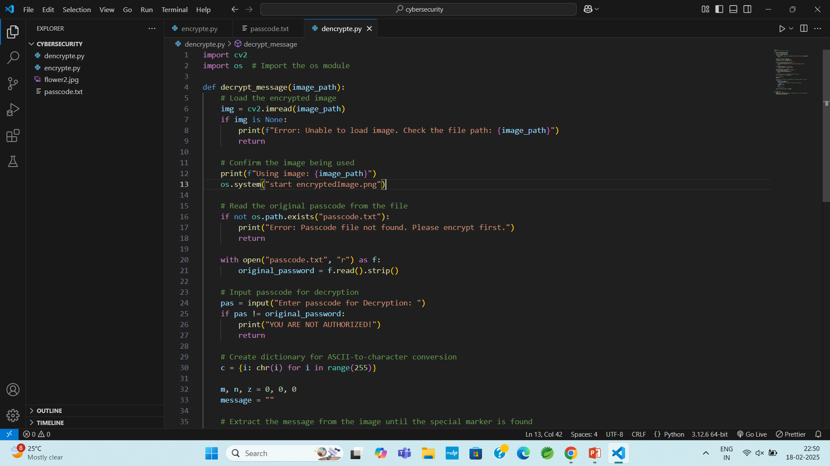
Results

Slide 8
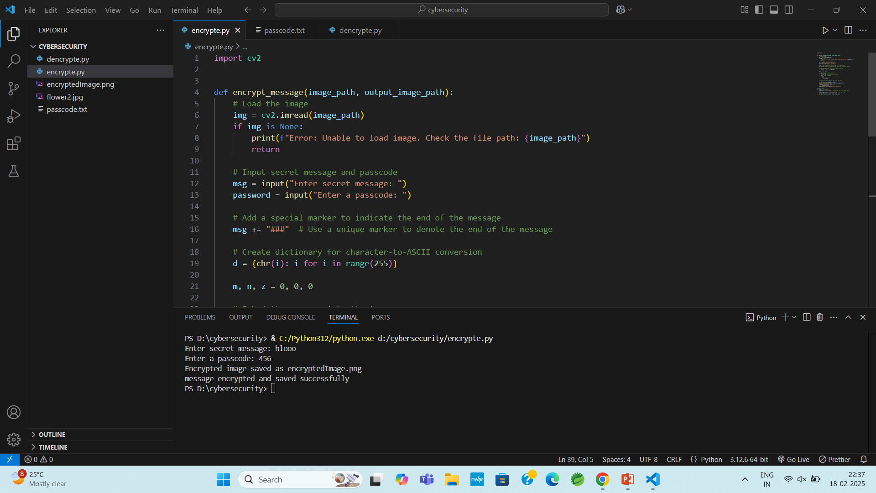

Slide 9
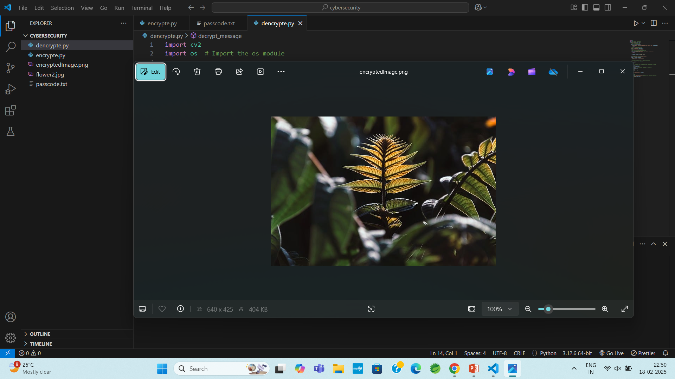



Slide 10
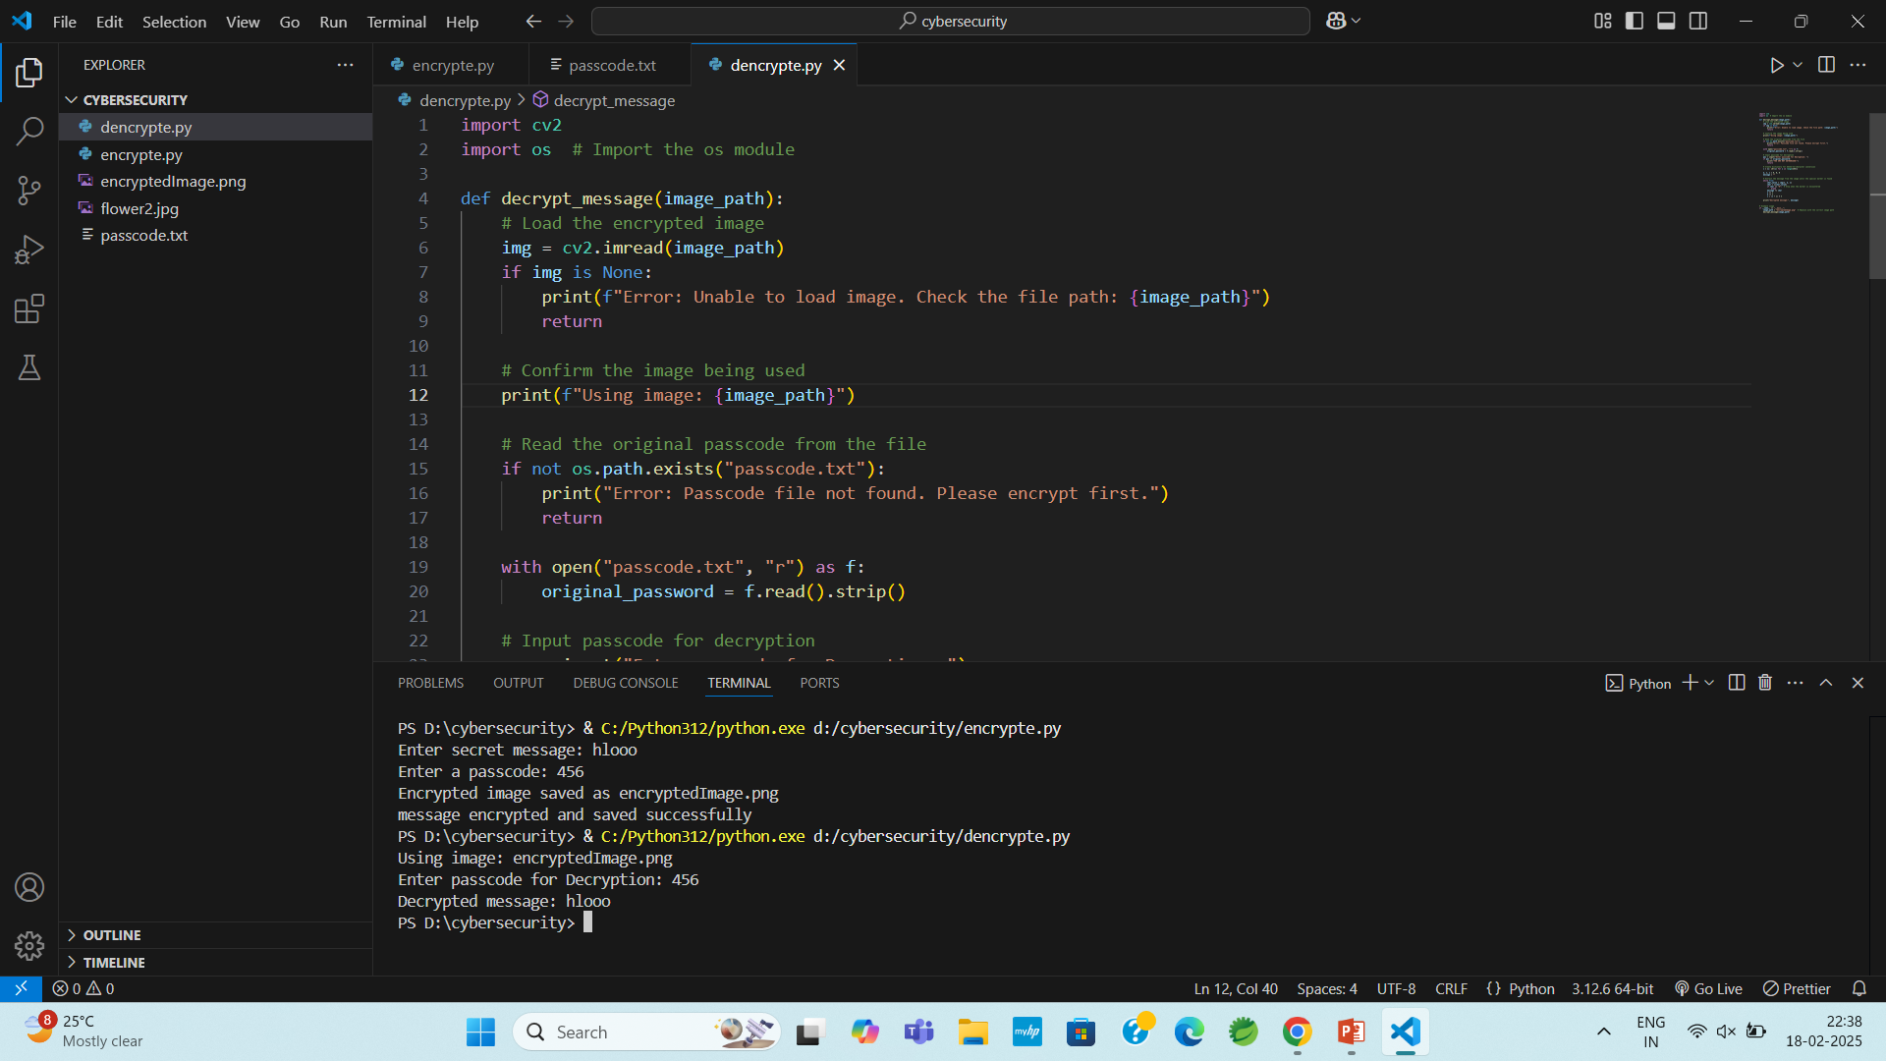

Slide 11
Conclusion
This project highlights a novel approach to embedding secret messages within images using Python. It demonstrates how pixel manipulation can be leveraged to store encrypted messages securely, ensuring that the information is only accessible to authorized users with the correct password. By utilizing OpenCV and Python, the project serves as a stepping stone for more complex steganographic systems.

Slide 12
GitHub Link
https://github.com/tasneemsultanasyed/AICTE---Cybersecurity.git

Slide 13
Future scope(optional)
User-Friendly Interface: Develop a GUI to allow users to easily upload images and input messages for encryption and decryption.
Advanced Steganography: Experiment with more sophisticated steganographic techniques to further obscure the presence of hidden messages.
Real-Time Encryption: Implement real-time encryption and decryption for video streams or image sequences, enabling dynamic data hiding in live feeds.
Enhanced Security:
Implement multi-pass encryption techniques to add multiple layers of protection.
Introduce checksum validation to verify message integrity.

Slide 14
THANK YOU

